Slide 1
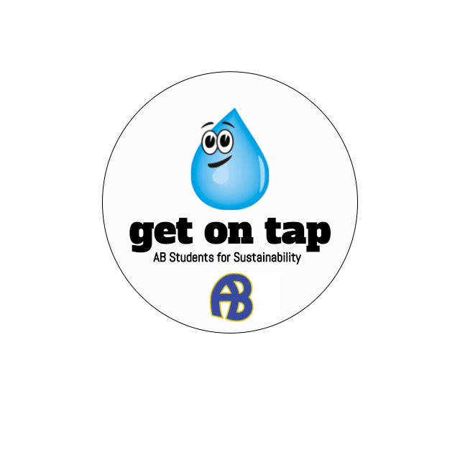
Get on Tap
Policy Proposal
School Committee Meeting: March 16, 2017
Anna Rychlik and Chantal Raguin

Slide 2
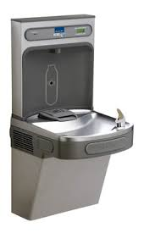
Bottle Filling Station - Donation
Danny’s Place UProject

Slide 3
Policy Objective:
To enrich student education, the district will promote consumption of local water and minimize importation of resources already available to the community. The district will encourage students to do the same through example and outreach. In establishing these practices, the district aims to guide formation of environmentally, healthfully, and fiscally sound habits.

Slide 4
Requested Procedures:
I
End district spending on bottled water.
II
Eliminate sale of bottled water on school grounds.
III
Encourage the use of local water at school sponsored events.
IV
Equip students and faculty with alternatives to bottled water.

Slide 5
Intended Results
Eco
Benefits
Health Benefits
Financial Benefits

Slide 6
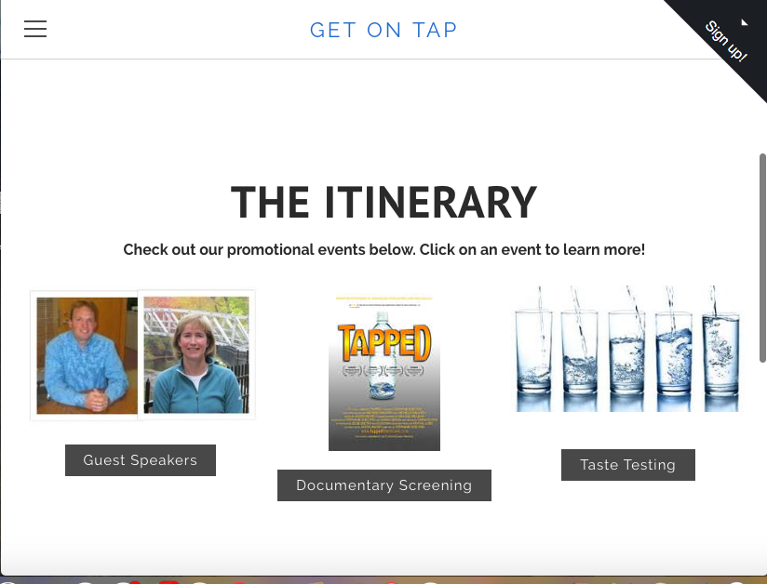
To Learn More...
getontap.weebly.com

Slide 7
Thank you for your time and consideration!

